Slide 1
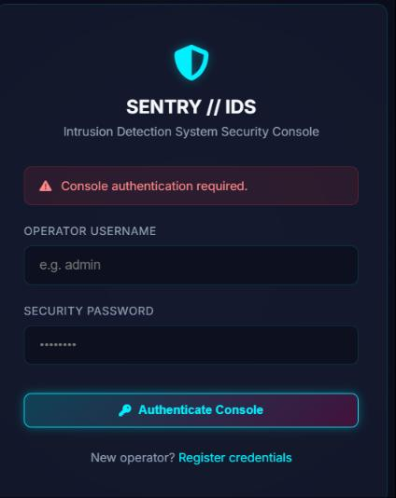
CYBER FORENSIC RESEARCH CENTRE
Madan Mohan Malaviya University of Technology, Gorakhpur
SENTRY-IDS
A Network Intrusion Detection System Using Snort and Wireshark
Submitted in Partial Fulfillment of the Internship Certificate in Cyber Security and Digital Forensics
Ashish (Roll No. 2405250100052) | Dhruva (Roll No. 2405250100070)
Under the Supervision of Dr. Vimal Kumar, Assistant Professor
July 2026

Slide 2
AGENDA
What We'll Cover
01
Introduction & Need for an IDS
02
Problem Statement & Objectives
03
IDS Types & Detection Techniques
04
Tool Landscape: Snort, Suricata, Zeek
05
Proposed System Architecture
06
Implementation & Detection Rules
07
Live Dashboard: SENTRY-IDS
08
Results, Performance & Conclusion
SENTRY-IDS | Network Intrusion Detection System Using Snort & Wireshark
2

Slide 3
INTRODUCTION
Why Networks Need an IDS
Firewalls and antivirus form the first line of defence, but they cannot reliably catch insider misuse, zero-day exploits, or malware already inside the network. An Intrusion Detection System continuously inspects traffic and activity to surface what perimeter defences miss.
CIA TRIAD FOCUS
An IDS helps preserve Confidentiality, Integrity, and Availability of information systems while assisting forensic investigation after an incident.
Rising volume & sophistication of cyberattacks
1980
IDS concept introduced by James P. Anderson
Detection of insider threats and APTs
Real-time monitoring and faster response
1987
First formal detection model — Dorothy Denning
Support for compliance (ISO 27001, NIST, PCI-DSS)
1998
Snort released by Martin Roesch
2020s
AI / ML-driven, cloud-aware IDS platforms
SENTRY-IDS | Network Intrusion Detection System Using Snort & Wireshark
3

Slide 4
THE CHALLENGE
Problem Statement & Objectives
PROBLEM STATEMENT
PROJECT OBJECTIVES
Modern networks generate huge volumes of traffic. Firewalls filter on fixed rules and cannot detect malicious behaviour occurring inside the network, encrypted attacker channels, or zero-day exploits — an intelligent, continuously monitoring IDS is required.
1
Study IDS concepts and architectures
2
Implement an IDS using Snort
3
Monitor real-time network traffic
4
Detect suspicious activity & cyberattacks
PROJECT SCOPE
Packet monitoring & rule-based detection
5
Generate real-time alerts for administrators
Real-time alert generation & logging
6
Evaluate performance with standard metrics
Performance evaluation of the IDS
Comparative analysis of detection tools
SENTRY-IDS | Network Intrusion Detection System Using Snort & Wireshark
4

Slide 5
FOUNDATIONS
Types of IDS & Detection Techniques
N
NIDS
H
HIDS
Network-Based
Host-Based
Monitors traffic across routers, switches & gateways. Examples: Snort, Suricata, Zeek.
Monitors logs, file integrity & activity on a single host. Examples: OSSEC, Wazuh, Tripwire.
DETECTION TECHNIQUES
Signature-Based
Anomaly-Based
Hybrid
Matches traffic to known attack patterns — fast, low false-positives, blind to zero-days.
Learns a normal-traffic baseline and flags deviations — catches unknown attacks, more false alarms.
Combines both approaches for higher accuracy and fewer missed or false alerts.
SENTRY-IDS | Network Intrusion Detection System Using Snort & Wireshark
5

Slide 6
LITERATURE REVIEW
The Open-Source IDS Landscape
Feature | Snort | Suricata | Zeek
Real-Time Detection | Yes | Yes | Yes
Signature-Based Detection | Yes | Yes | Limited
Protocol Analysis | Good | Very Good | Excellent
Multi-Threading | No | Yes | Yes
Open Source | Yes | Yes | Yes
WHY SNORT?
Open source & highly customizable
Large, active community rule database
Simple integration with SIEM tools
Well-documented, mature (since 1998)
Ideal for educational deployment
Snort remains attractive for its maturity, simplicity, and large community rule base — making it the practical choice for SENTRY-IDS. Suricata offers superior throughput via multi-threading; Zeek gives the richest behavioural visibility but needs more admin expertise.
SENTRY-IDS | Network Intrusion Detection System Using Snort & Wireshark
6

Slide 7
SYSTEM DESIGN
Proposed IDS Architecture
1
2
3
4
5
Packet Capture
→
Packet Decoder
→
Detection Engine
→
Alert Generation
→
Admin Dashboard
Libpcap captures all packets on the network interface
Extracts IP, port, protocol & payload details
Compares packets against the Snort rule database
Logs the event and raises a real-time alert
Analyst reviews alerts and responds
NETWORK TOPOLOGY
Internet
→
Router / Firewall
→
Network Switch
→
Snort IDS + PCs
Core components: Packet Capture • Packet Decoder • Detection Engine • Rule Database • Alert Management System
SENTRY-IDS | Network Intrusion Detection System Using Snort & Wireshark
7

Slide 8
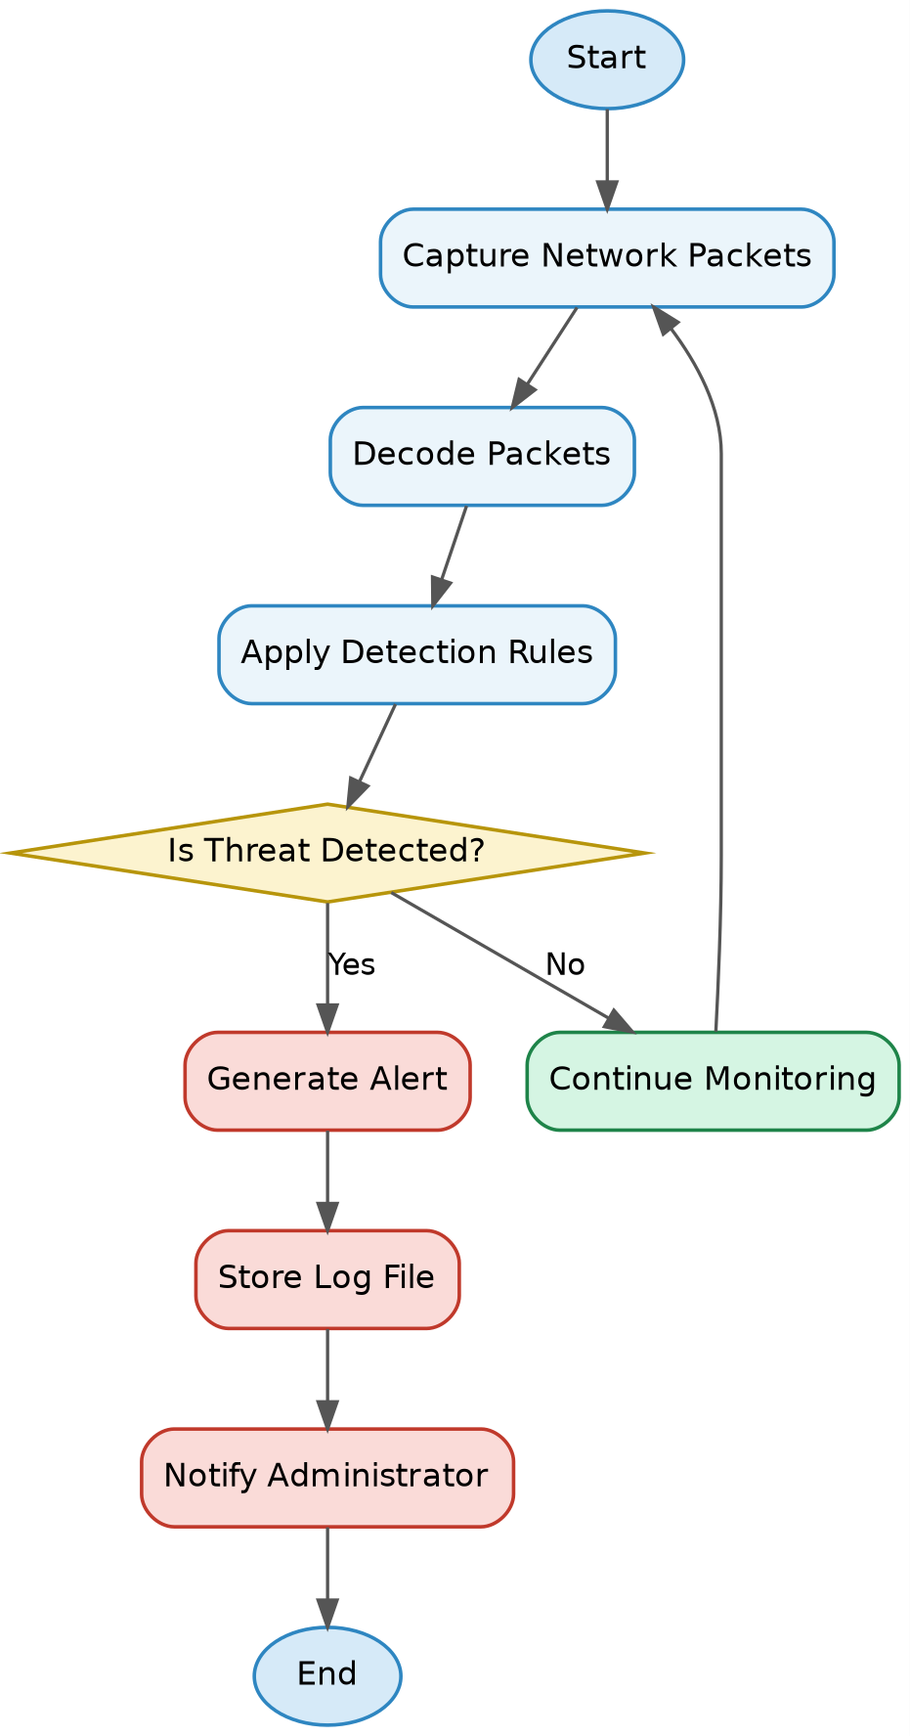
SYSTEM DESIGN
End-to-End Detection Workflow
1
Capture
Live packets are pulled from the selected interface in real time.
2
Decode & Match
Packets are decoded and checked against the Snort rule set.
3
Decide
A threat verdict is reached for every packet inspected.
4
Alert & Log
Matches trigger an alert and are written to the log store.
5
Notify
The administrator is notified to review and respond.
SENTRY-IDS | Network Intrusion Detection System Using Snort & Wireshark
8

Slide 9
IMPLEMENTATION
Environment & Setup
HARDWARE
SOFTWARE
Component | Specification
Processor | Intel Core i5 or higher
RAM | Minimum 8 GB
Storage | 50 GB free disk space
Network Adapter | Ethernet / Wi-Fi
Architecture | 64-bit
Software | Purpose
Ubuntu 22.04 LTS | Operating System
Snort 3 | Intrusion Detection Engine
Wireshark | Packet Analyzer
Python 3 | Log Analysis
Nmap | Attack Simulation
VirtualBox | Virtual Environment
$ sudo apt install snort -y $ sudo snort -c /etc/snort/snort.lua -i eth0
Snort is installed on Ubuntu, configured via snort.lua (HOME_NET / EXTERNAL_NET), then run in IDS mode against the live interface.
SENTRY-IDS | Network Intrusion Detection System Using Snort & Wireshark
9

Slide 10
IMPLEMENTATION
Detection Rules & Attack Simulation
SAMPLE SNORT RULES
ATTACK SIMULATION SCENARIOS
ICMP Ping Detected
Port Scanning
Nmap SYN scan
alert icmp any any -> $HOME_NET any (sid:100001;)
➔ Port Scan Detected
FTP Connection Detected
ICMP Flood
ping -f
alert tcp any any -> $HOME_NET 21 (sid:100002;)
➔ ICMP Flood Attack Detected
SSH Connection
SSH Brute Force
Repeated login attempts
alert tcp any any -> $HOME_NET 22 (sid:100003;)
➔ Possible SSH Brute Force Attack
HTTP Traffic
HTTP Monitoring
Browser web access
alert tcp any any -> $HOME_NET 80 (sid:100004;)
➔ HTTP Traffic Detected
SENTRY-IDS | Network Intrusion Detection System Using Snort & Wireshark
10

Slide 11
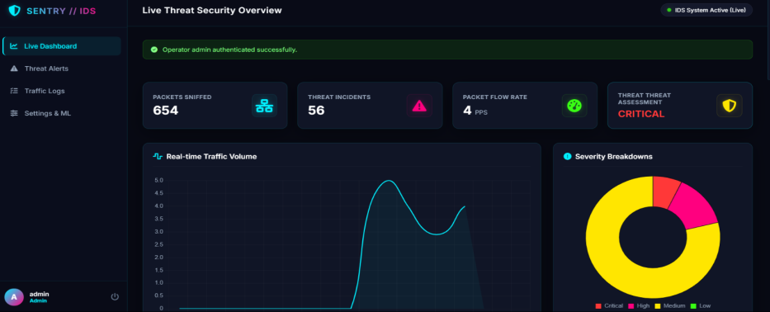
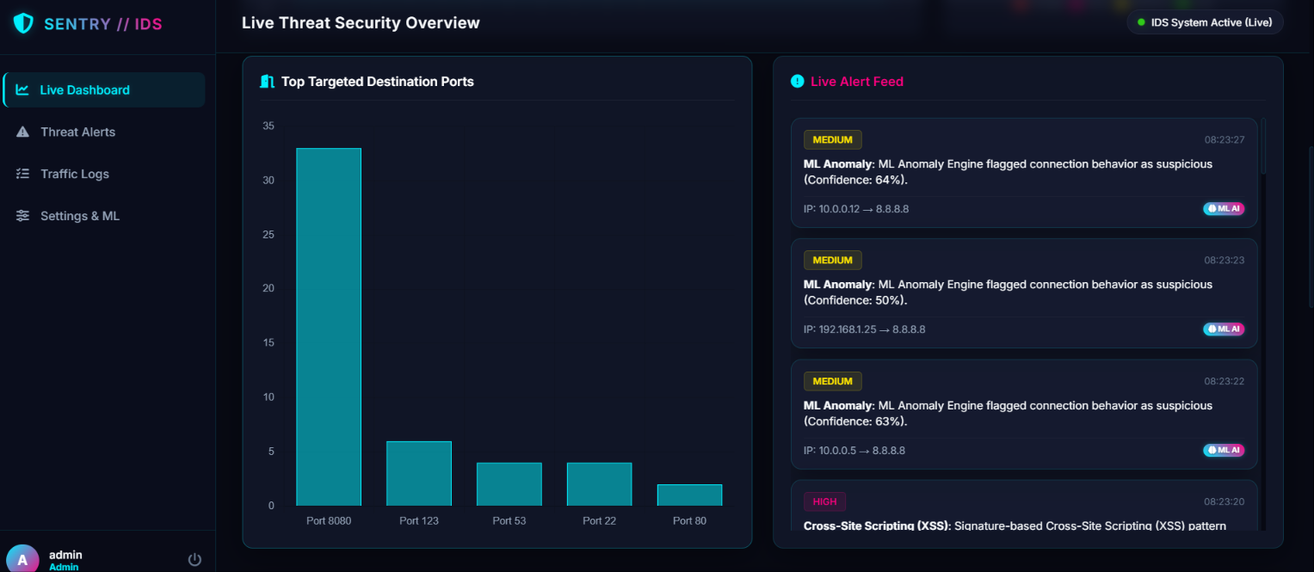
LIVE MONITORING
The SENTRY-IDS Console
Operators authenticate into a secure console, then get a live view of packet throughput, threat severity, and incoming alerts.
Operator Authentication Console
Secured console access restricts dashboard use to registered operators before any live data is shown.
Live Threat Security Overview
Real-time packet counts, incident totals, flow rate, and severity breakdown update continuously as traffic is analysed.
SENTRY-IDS | Network Intrusion Detection System Using Snort & Wireshark
11

Slide 12
RESULTS
Attack Detection Results
Attack Type | Detection Status | Alert Generated
Port Scan | Detected | Yes
ICMP Flood | Detected | Yes
SSH Brute Force | Detected | Yes
HTTP Traffic | Detected | Yes
Normal Traffic | No Attack | No Alert
CONFUSION MATRIX
 | Predicted Attack | Predicted Normal
Actual Attack | TP | FN
Actual Normal | FP | TN
The majority of attack instances were correctly classified as True Positives, with only a small number of False Negatives / False Positives.
All four simulated attack categories were correctly flagged with alerts, while normal baseline traffic passed through without any false alarm — confirming reliable rule matching across attack types.
SENTRY-IDS | Network Intrusion Detection System Using Snort & Wireshark
12

Slide 13
RESULTS
Performance Metrics
98.2%
97.5%
96.8%
97.1%
2.1%
Detection
Accuracy
Precision
Recall
F1-Score
False Positive
Rate
RESOURCE FOOTPRINT
HOW IT'S MEASURED
Average CPU Usage
18%
Accuracy = (TP+TN) / All
Precision = TP / (TP+FP)
Recall = TP / (TP+FN)
F1 = harmonic mean of
Precision & Recall
Average Memory Usage
310 MB
Snort keeps a light footprint on modest, i5-class hardware — well suited to small and medium network deployments.
SENTRY-IDS | Network Intrusion Detection System Using Snort & Wireshark
13

Slide 14
DISCUSSION
How SENTRY-IDS Compares
Feature | Snort (Used) | Suricata | Zeek
Real-Time Detection | Yes | Yes | Yes
Signature-Based | Yes | Yes | Limited
Protocol Analysis | Good | Very Good | Excellent
Multi-Threading | No | Yes | Yes
LIMITATIONS
–
Cannot detect zero-day attacks (signature-based)
–
Detection depends on regularly updated rules
–
High-speed links need stronger hardware
KEY DISCUSSION POINTS
All four attack categories were detected without disrupting normal traffic
–
Encrypted traffic limits inspection
Stable CPU/memory usage under both idle and attack conditions
–
Detects — does not automatically block
Main effort went into rule tuning to reduce false positives
SENTRY-IDS | Network Intrusion Detection System Using Snort & Wireshark
14

Slide 15
CONCLUSION
An Effective, Low-Cost Security Layer
SENTRY-IDS demonstrates that an open-source stack — Snort for detection and Wireshark for packet analysis — can reliably monitor traffic, detect common cyberattacks, and generate actionable, forensic-ready alerts on modest hardware.
KEY ACHIEVEMENTS
Designed & implemented a full NIDS pipeline
Installed, configured & tuned Snort 3
Captured & analysed live traffic with Wireshark
Authored custom detection rules
Detected multiple real attack types
Built the SENTRY-IDS live alert dashboard
Logged events for forensic analysis
Benchmarked accuracy, precision, recall & F1
98.2%
Overall detection accuracy achieved across port-scan, ICMP-flood, SSH brute-force, and HTTP-monitoring test scenarios — with a false-positive rate of just 2.1%.
SENTRY-IDS | Network Intrusion Detection System Using Snort & Wireshark
15

Slide 16
LOOKING AHEAD
Future Scope
1
2
3
Machine Learning
IPS Integration
Cloud & IoT Coverage
Anomaly detection to catch unknown / zero-day attacks
Automatically block malicious traffic after detection
Extend monitoring to cloud workloads and IoT devices
4
5
6
SIEM Integration
Live Dashboard+
Threat Intelligence
Centralise logs & response via Splunk / Elastic Stack
Richer graphical, real-time monitoring dashboard
Connect external feeds for emerging threat data
SENTRY-IDS | Network Intrusion Detection System Using Snort & Wireshark
16

Slide 17
Thank You
Questions & Discussion
Ashish Dubey • Dhruva Khare
Under the Supervision of Dr. Vimal Kumar
Cyber Forensic Research Centre • Dept. of Computer Science & Engineering • MMMUT, Gorakhpur

